Slide 1
The Case For FHIR
Overview and Use in Med Rec
Robert Hausam MD
4/5/19

Slide 2
introduction to hl7 fhir

Slide 3


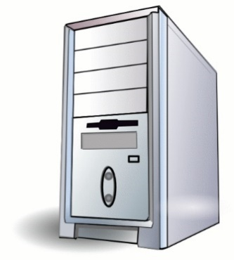

What is FHIR?
Standard to share healthcare data
Why?
Better patient care
More efficient delivery
How?
The right data
to those who need it
when they need it
wherever it’s from

Slide 4
What makes a “successful” standard?
Well-Defined
What data?
What meaning?
How shared?
Cheap,
Easy
Widely Implemented
Used Consistently
Same problem = same solution

Slide 5


A word of caution

Slide 6
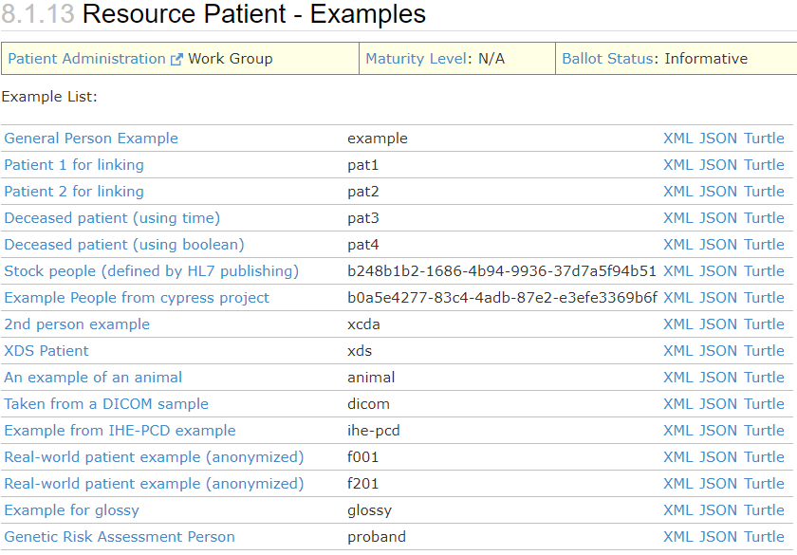
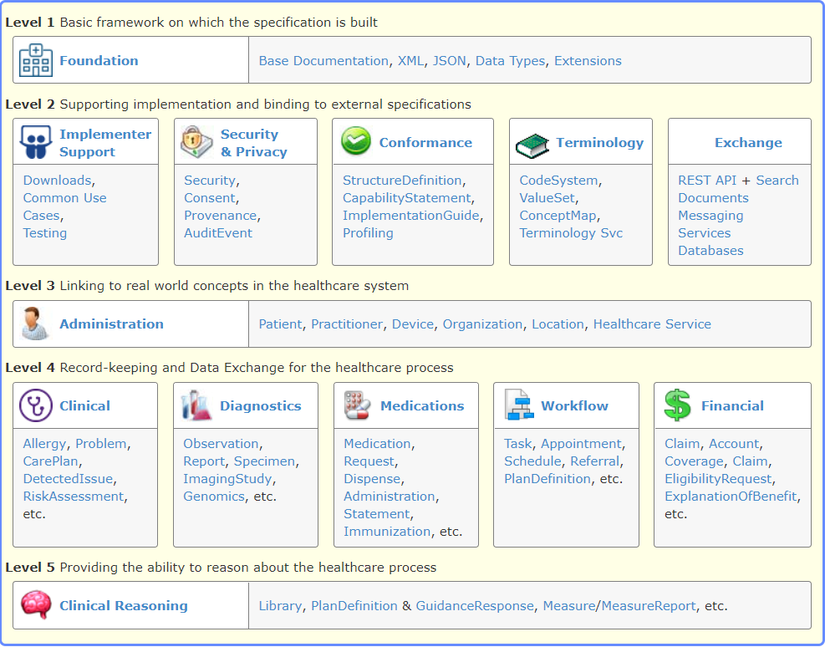
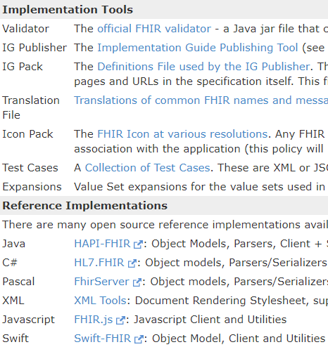
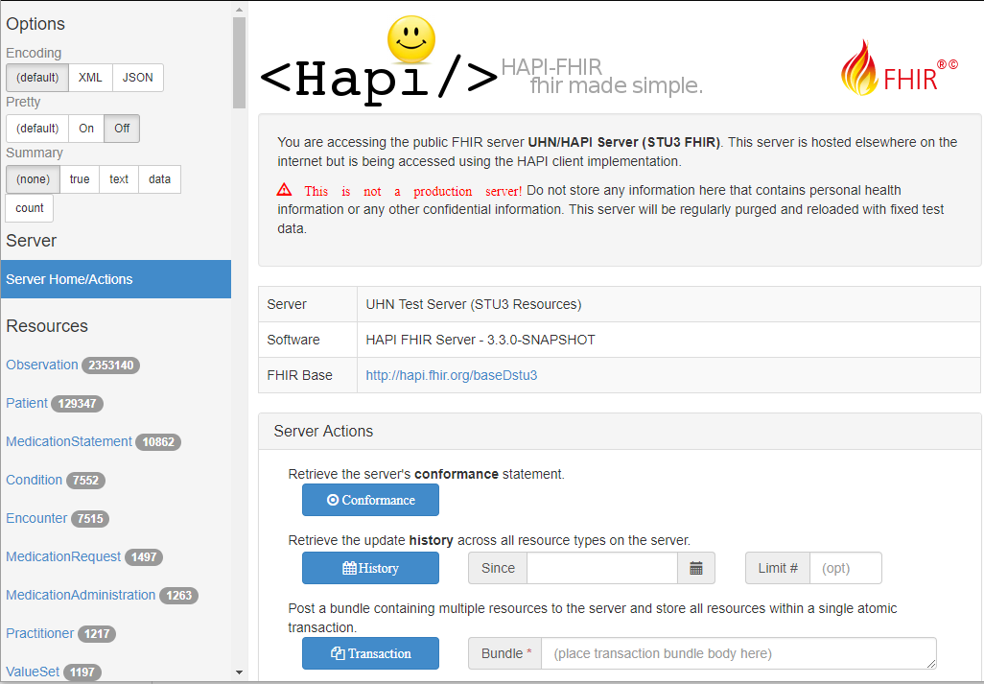
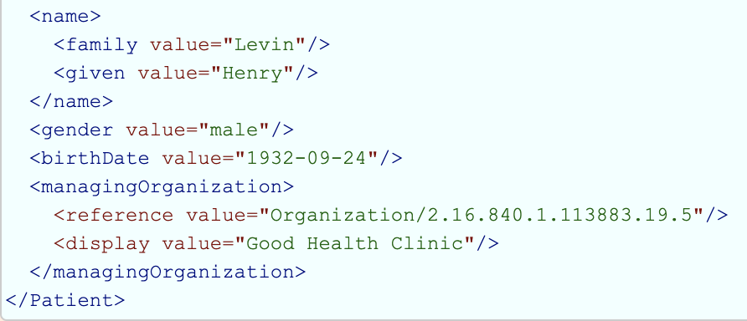
1. Focus on implementers

Slide 7

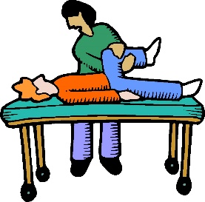





2. Simple, with extensibility
Healthcare

Slide 8




2. Simple, with extensibility
Healthcare
FHIR
(core)

Slide 9
2. Simple, with extensibility
Extensions & Profiles are:
Resolvable
Sharable
Discoverable
Testable
Result
Easy to understand
Can do complex things
Systems can evolve & still interoperate
FHIR
(core)

Slide 10
Example (ISO AD type)
isNotOrdered, updateMode, flavorId, nullFlavor, controlAct root & extension, validTime low and high, useable period (GTS – no room on the slide), use
home, primary home, vacation home, workplace, direct, public, bad, physical, postal, temporary, alphabetic, ideographic, syllabic, search, soundex, phonetic
0..* parts, each with:
value, code, code system, code system name, code system version, language, type:
address line, additional locator, unit identifier, unit designator, delivery address line, delivery installation type, delivery installation area, delivery installation qualifier, delivery mode, delivery mode identifier, street address line, building number, building number numeric, building number suffix, street name, street name base, street type, direction, intersection, care of, census tract, country, county or parish, municipality, delimiter, post box, precinct, state or province, postal code, delivery point identifier
Notes:
How many of your systems have user interfaces that support even ¼ of this?

Slide 11
Example (FHIR Address)
isNotOrdered, updateMode, flavorId, nullFlavor, controlAct root & extension, validTime low and high, useable period (low, high) (GTS – no room on the slide), use
home, primary home, vacation home, workplace, direct, public, bad, physicalvisit, postal, temporary, alphabetic, ideographic, syllabic, search, soundex, phonetic, old
0..* parts, each with:text
value, code, code system, code system name, code system version, language, type:
address line, additional locator, unit identifier, unit designator, delivery address line, delivery installation type, delivery installation area, delivery installation qualifier, delivery mode, delivery mode identifier, street address line, building number, building number numeric, building number suffix, street name, street name base, street type, direction, intersection, care of, census tract, country, county or parish, municipalitycity, delimiter, post box, precinct, state or province, postalCode, delivery point identifier
Notes:
This is what happens when you apply the 80% . . .

Slide 12



3. Modern technology
Use HTTP stack
API, security informed by:
Syntax
XML, JSON, RDF
FHIR is web-based and free
Result:
Easy to find people / build skills
No expensive consultants
Lots of (free) tools
Built-in support in most languages
I.e. cheaper / faster / easier

Slide 13
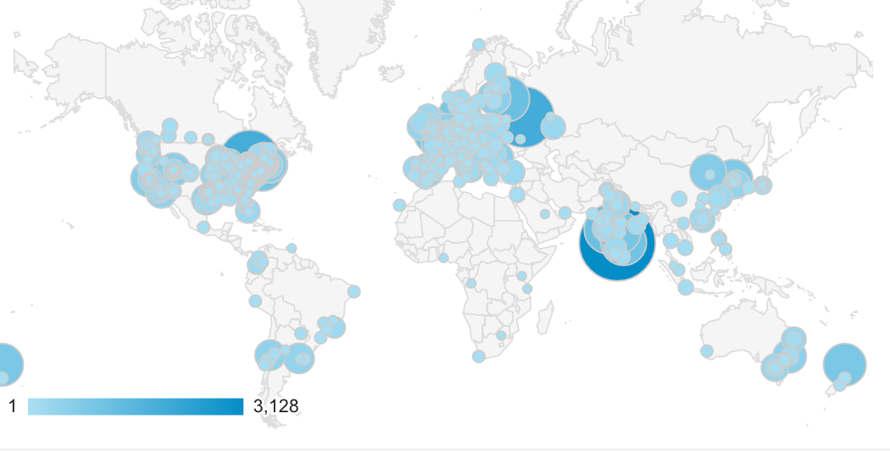
4. Community

Slide 14

4. Community
Guidance & support
http://chat.fhir.org (Zulip)
Connectathons
Tools
Consensus

Slide 15
Summary
Standard to share healthcare data
Enables improved adoption & consistent implementation
Designed for implementers
Simple but extensible
Modern technology
Strong community
Enables better & more efficient healthcare

Slide 16
WHY FHIR?
Let’s go a bit deeper

Slide 17

http://xkcd.com/927

Slide 18
Existing healthcare standards and bodies
HL7 – v2, v3, CDA
OpenEHR
CDISC – SDTM, ADAM, define.xml
X12
CTS
ISO – 11179, 21090, etc.
DICOM
W3C – Xforms, XSD
Many others
Do we really need one more?

Slide 19
The Need
Has been a need to share healthcare information electronically for a long time
HL7 v2 is over 30 years old
Increasing pressure to broaden scope of sharing
Across organizations, disciplines, even borders
Mobile & cloud-based applications
Faster – integration in days or weeks, not months or years

Slide 20
What we have
V2
Works relatively well within institutions, but is legacy and has lots of limitations
V3
Newer, with semi-robust reference model, but has a steep learning curve
CDA
Still has a steep learning curve and document architecture doesn’t fit for all problems

Slide 21
Where we’ve gotten
v2, v3 and CDA have produced “bigger” silos
Different IGs / implementations create barriers
Interoperating still requires painful mapping & transformation exercises.
Low discoverability – lots of technical discussions needed before data can flow
Silos are inevitable – differing requirements
But need to lower the barriers and reduce time to build connections between them

Slide 22
So I should drop everything and use FHIR?
Tossing functioning systems the instant a promising newcomer appears is not generally a wise strategy
There’s room for something better
FHIR tries to fill that gap
Market will decide whether FHIR survives, coexists or replaces other products
Effort spent on v2, v3 & CDA can be still be leveraged
Notes:
There are flaws in what exists
There are new use-cases not being met

Slide 23
Complexity Model
Snomed
HL7 V3
openEHR
WS
CDA
Difficulty (log)
XML
HL7 v2
How?
HTTP / HTML
Text
Semantic Depth

Slide 24
What is FHIR? Further look
And how is it different?

Slide 25
The acronym
F – Fast (to design & to implement)
Relative – No technology can make integration as fast as we’d like
H – Healthcare
That’s why we’re here
I – Interoperable
Ditto
R – Resources
Building blocks – more on these to follow

Slide 26
FHIR – Key differences
Focus on Implementers
Target support for common scenarios
Leverage cross-industry web technologies
Require human readability as base level of interoperability
Make content freely available
Support multiple paradigms & architectures
Demonstrate best practice governance
Notes:
We don’t actually have a formal manifesto, but these are the principles we adhere to.

Slide 27
Implementer Focus
Specification is written for one target audience: implementers (that’s not just programmers)
Rationale, modeling approaches, etc. kept elsewhere
Multiple reference implementations from day 1
Publicly available test servers
Starter APIs published with spec
C#, Java, Pascal, Swift, more coming
Connectathons to verify specification approaches
Instances you can read and understand ☺
Lots of examples (and they’re valid too)
using HL7.Fhir.Instance.Model;
using HL7.Fhir.Instance.Parsers;
using HL7.Fhir.Instance.Support;
XmlReader xr = XmlReader.Create(
new StreamRead
IFhirReader r = new XmlFhirReader
// JsonTextReader jr = new JsonTe
// new StreamRead
// IFhirReader r = new JsonFhirRe
ErrorList errors = new ErrorList(
LabReport rep = (LabReport)Resour
Assert.IsTrue(errors.Count() == 0
Notes:
Spec is driven by people who write code
Numerous pieces have been changed because of experience with what worked when trying to implement
Even have a test workbench for RESTful servers

Slide 28
Support “Common” Scenarios
Inclusion of content in core specification is based on “80%” rule
Only include data elements we are confident that most (~80%) of normal implementations using that resource will make use of
Other content in extensions (more on this later)
Easy to say, governance challenge to achieve
Resources are simple and easy to understand & use
80%
Notes:
Design by constraint failed – years to develop, what was produced required yet more design to be implementable and after that might not be interoperable
How to determine the 80%? Look to existing specs – v2, v3, CDA templates, OpenEHR, jurisdictional projects, what implementations we’ve seen
If not sure, err on the side of “not in for now”
Note: not 80% of instances, 80% of implementations
Challenges with “raising the bar”
What happens when there aren’t many/any implementations?

Slide 29
Web technologies
Instances shared using XML & JSON
Web calls work the same way they do for Google & Twitter
Rely on HTTPS, OAuth, etc. for security functions
Benefits
Cross-Industry standards
Well supported by tools
Understood by developers
http://...
Notes:
We try very hard to *not* invent stuff that exists elsewhere unless it’s really broken or totally unaligned with the FHIR principles.

Slide 30

Human Readable
Clinical Documents have both narrative and data (like CDA)
The data / narrative dynamic exists throughout the process
In FHIR, every resource can (should) have a human-readable expression
Can be direct rendering or human entered
Notes:
Even when you think your target will understand all the encoded data, reality is data often gets shared beyond the originally intended context
Allow for exceptions for things like automated device readings, etc.

Slide 31
Freely available
Unencumbered – free for use, no membership required
http://hl7.org/fhir + other versions
Licensed under CC0: True public domain
Any use is allowed
HL7 enforces the trademark protection
Business model:
If you want to vote, you need to pay
Notes:
Was a bigger deal before HL7 decided to open up all IP
Link to full legal text towards bottom of FHIR home page

Slide 32
Paradigms
FHIR supports 4 interoperability paradigms
REST
Documents
Messages
Other
What should you use when?
Notes:
Temperature check – how many people feel they’ve got a good handle on the paradigms and when they’d use them vs. not. (This isn’t really FHIR-specific)

Slide 33
Paradigms
REST – Lightweight, leverages web stack
Documents – Long-term persistence
Messages – Request/response paradigm
Other – Services, other SOA-based interfaces
Regardless of the approach, the content stays the same
Can leverage same models, same profiles everywhere

Slide 34

Architectures
FHIR makes no assumptions about the architectural design of systems
You can use it for
Light or heavy clients
Central server or peer-to-peer sharing
Push or pull
Query or publish/subscribe
Loosely coupled or tightly coupled environments
With history tracking or without

Slide 35
Some possible uses
v3
App
v2
FHIR
PHR
FHIR
Broker
Comm.
Interface
FHIR
DB
Notes:
You’re a message broker routing and translating between v2, v3 and FHIR
Your app interfaces with a PHR using FHIR natively
Your application can communicate using FHIR, but your software uses a proprietary RDBMS
Use FHIR as the common language for a Vendor Neutral Archive
…Or a combination….
You might see data as a nested structure of XML, a series of tables with keys, class-diagrams….

Slide 36
FHIR Resources

Slide 37
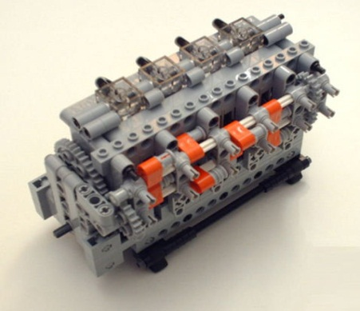
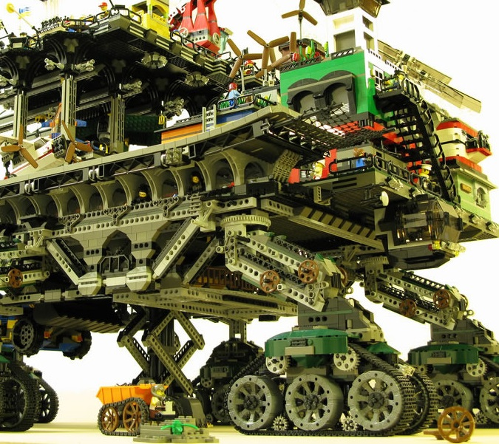

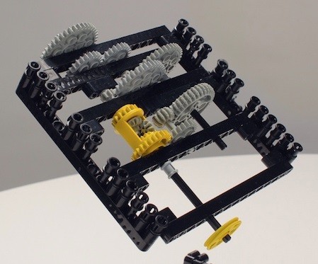
FHIR solutions
Resources
Extensions
Solution
+
=
Notes:
Resources are building blocks, but useful in their own right
Extensions supplement what resource doesn’t cover
Solutions can be simple or complex

Slide 38

Resources
“Resources” are:
Small logically discrete units of exchange
Defined behavior and meaning
Known identity / location
Smallest unit of transaction
“of interest” to healthcare
V2: Sort of like Segments
V3: Sort of like CMETs

Slide 39
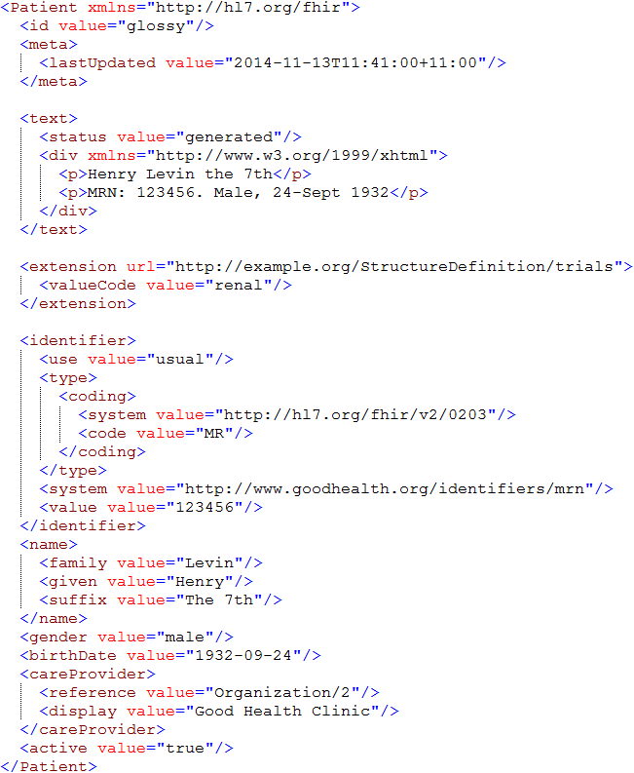
Resource Instance
Identity & Metadata
Human Readable Summary
Extension with reference to its definition
Standard Data Content:
MRN
Name
Gender
Date of Birth
Provider

Slide 40
FHIR Resource URLs
Template | Description | Example | Operations
[base] | Server URL | http://fhir.com | GET, POST
[base]/[type] | Collection Manager | http://fhir.com/Patient | GET, POST
[base]/[type]/[id] | URL for a resource | http://fhir.com/Patient /23 | GET, PUT, DELETE, PATCH
[base]/[type]/[id]/_history/[vid] | Past version | http://fhir.com/Patient/23/_history/2 | GET
[base]/([type]/([id]/)?)?$[name] | Operation (server action) | http://fhir.com/Patient /23/$everything | GET or POST

Slide 41
What’s a Resource?
Examples
Non-examples
Administrative
Patient, Practitioner, Organization, Location, Coverage, Invoice
Clinical Concepts
Allergy, Condition, Family History, Care Plan
Infrastructure
Document, Message, Profile, Conformance
Gender
Too small
Electronic Health Record
Too big
Blood Pressure
Too specific
Intervention
Too broad
100-150 total - ever
Notes:
And few systems will ever see more than 40-50

Slide 42
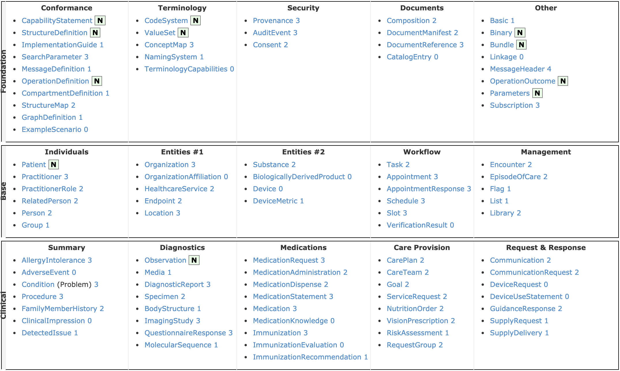
Resource List (R4)

Slide 43
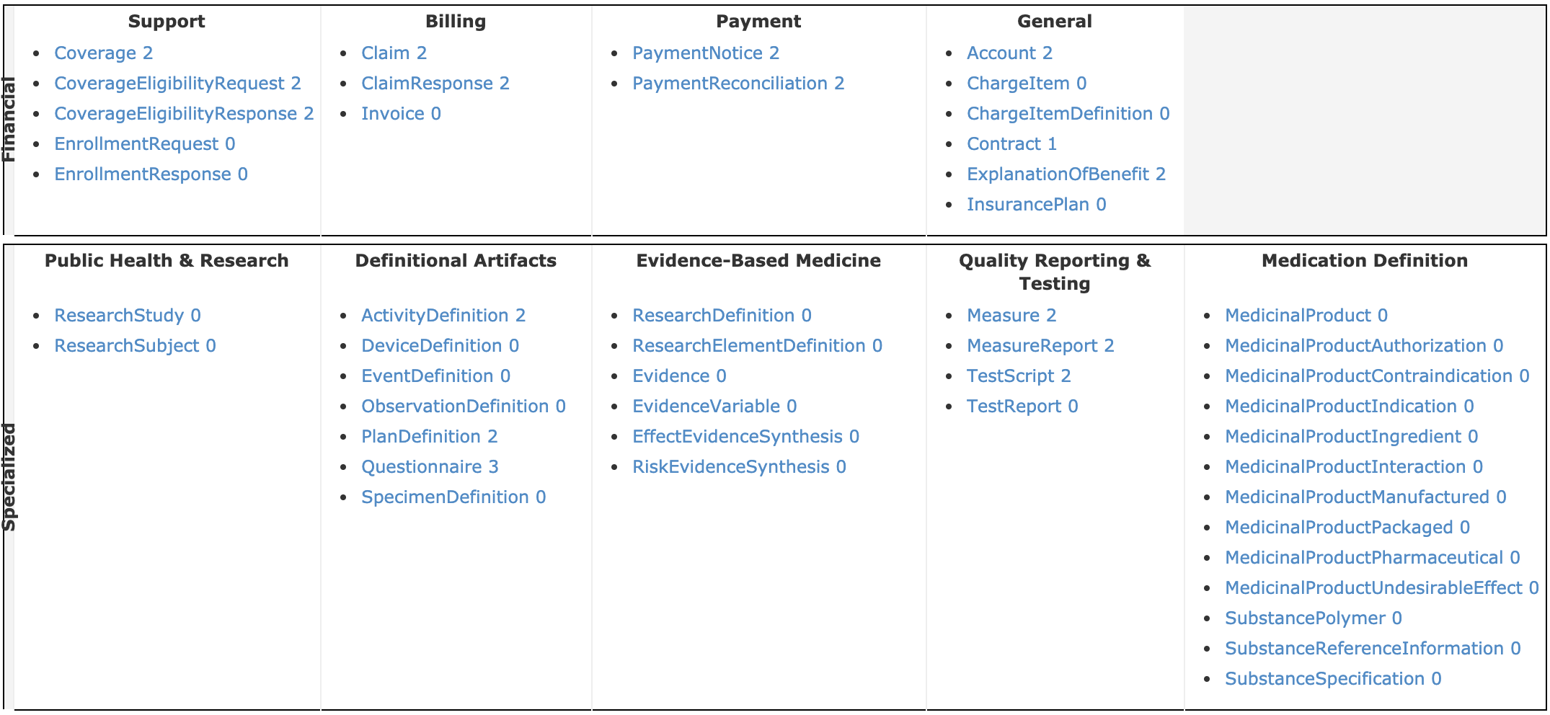
Resource List (R4)

Slide 44
What’s in a resource definition?
Each resource defines:
What elements are part of “core”
Names
Definitions
Cardinality
Code lists
Mappings (to RIM, v2 and other specs)
Constraints
All in a computable form
Create spec, schemas, reference implementations

Slide 45
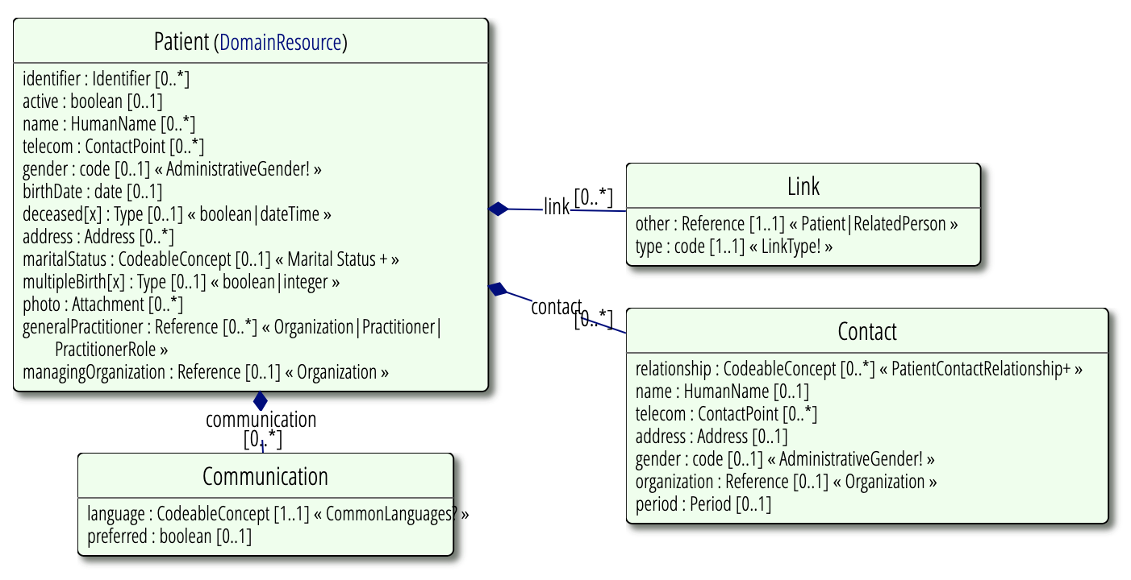
Resource Definitions
UML

Slide 46
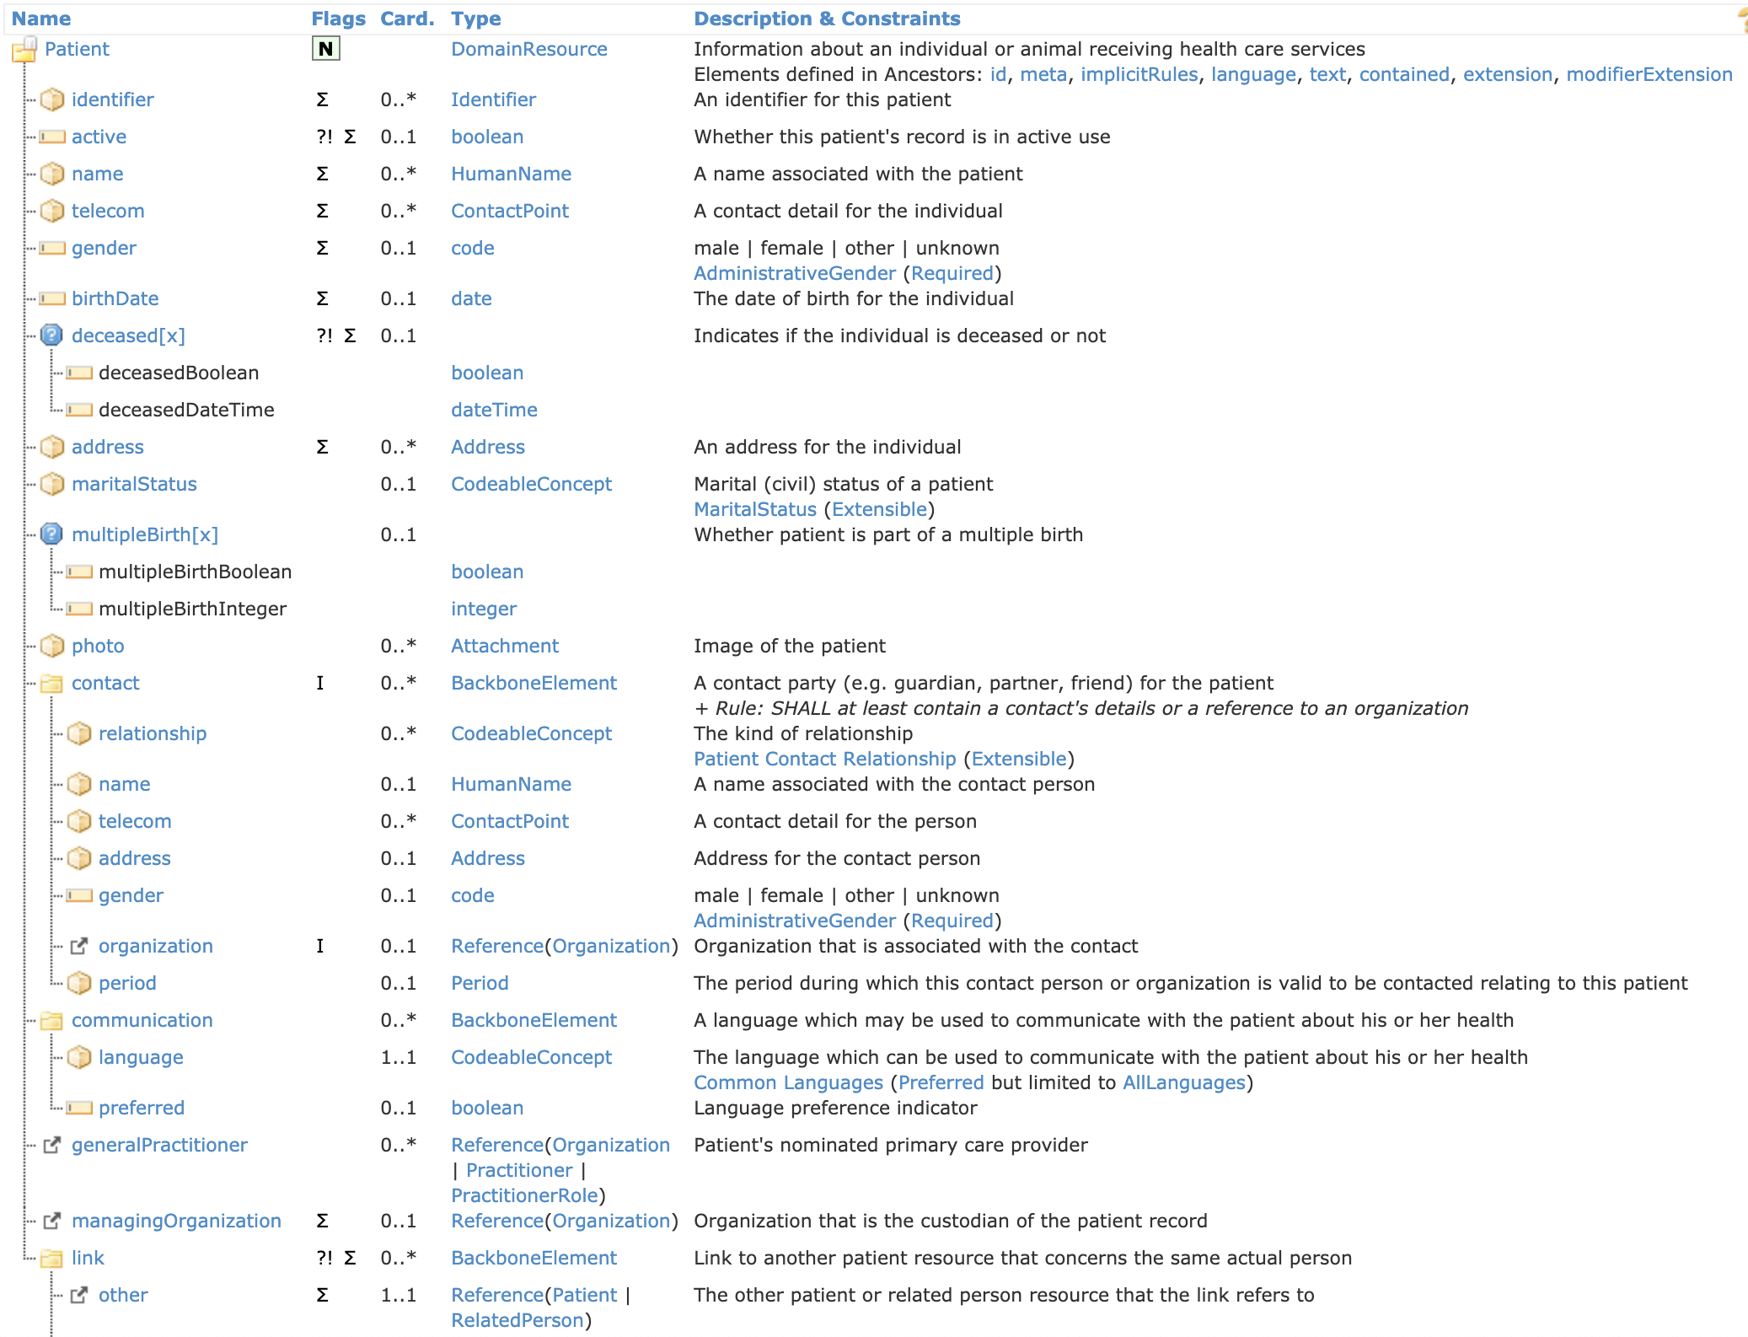
Structure

Slide 47
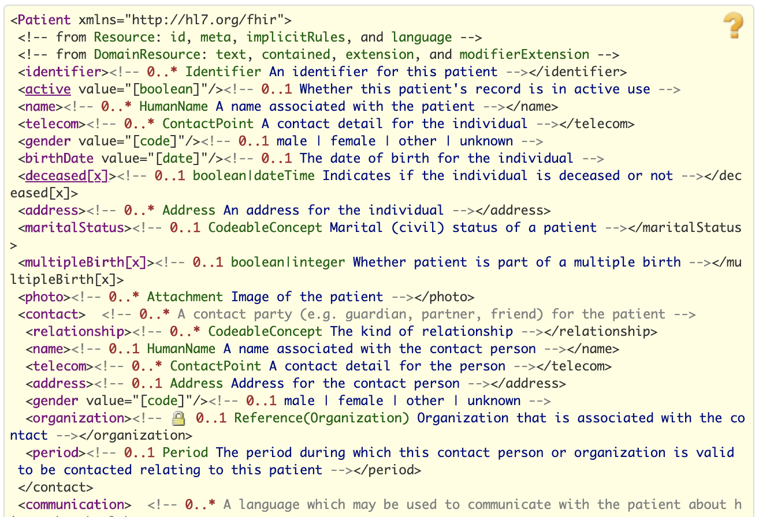
XML

Slide 48
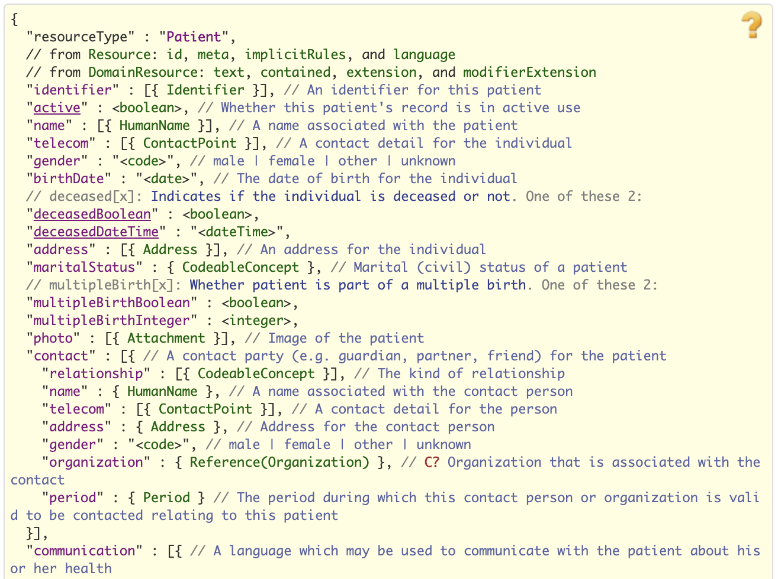
JSON

Slide 49
Why resources?
Increases re-use
Can use the same resource structures (and profiles on them) in many solutions
Lighter-weight communication
Can point to resources “by reference” rather than sending all data
Aligns well with how data is stored

Slide 50
Fhir specification status

Slide 51
Normative FHIR
Published FHIR R4 (version 4.0.0) on 12/27/2018
The R4 release contains the first normative content
Normative:
Expected to be relatively stable
Can be relied on for implementation (lower risk)
No changes without community consultation and agreement
Binary, Bundle, CapabilityStatement, CodeSystem, Observation, OperationDefinition, OperationOutcome, Parameters, Patient, StructureDefinition, ValueSet
More normative content in future releases (R5 and following)

Slide 52
Using FHIR

Slide 53
Where can FHIR be used?
Classic in-institution interoperability
Back-end e-business systems (e.g. financial)
Regional Health Information Organizations (RHIO)
National EHR systems
Social Web (Health)
Mobile Applications

Slide 54
Who’s working with FHIR?
> 1000 organizations
attended a Connectathon and/or
implementation work in progress
Hard to track who’s doing what
Over 500 active participants on the FHIR Implementer’s chat
http://chat.fhir.org
25+ countries involved so far

Slide 55
Who’s using FHIR?
Systems accessing HAPI server in previous year (as of 2017-05)
Notes:
Jan->mid Nov. 2015 – unique systems accessing the HAPI test server

Slide 56


FHIR & other SDOs
IHE
Using FHIR for MHD (mobile XDS)
FHIR profile for PIX/PDQ, CMAP, RECON, Accountable Order, ATNA, 10+ more
DICOM
Building profile to make key images available to EHR
W3C
Semantic health group helping us with RDF, RIM-based semantic checking
Notes:
Because FHIR is free and because of how it’s structured, use by other SDOs is certainly possible CMAP = Clinical Mapping; RECON = reconciliation, Assessment of orders for accountable use criteria in guidelines

Slide 57
Governments
US – ONC
Sponsored projects, including mapping meaningful use to FHIR
UK
Live implementation, lots more in the pipeline
Lithuania
Chose FHIR as the basis for their national EHR
Others

Slide 58
EHR Vendors
Many significant EHR vendors have made commitments to FHIR implementation
AllScripts, Cerner, Epic, McKesson, Meditech
Voluntarily investing in accelerating the standard
E.g. Argonaut, participating in standards development

Slide 59
Other support
Large and small healthcare organizations
E.g. Mayo, Intermountain Healthcare, University Health Network
Small vendors, start-ups
Lots and lots – all over the world

Slide 60



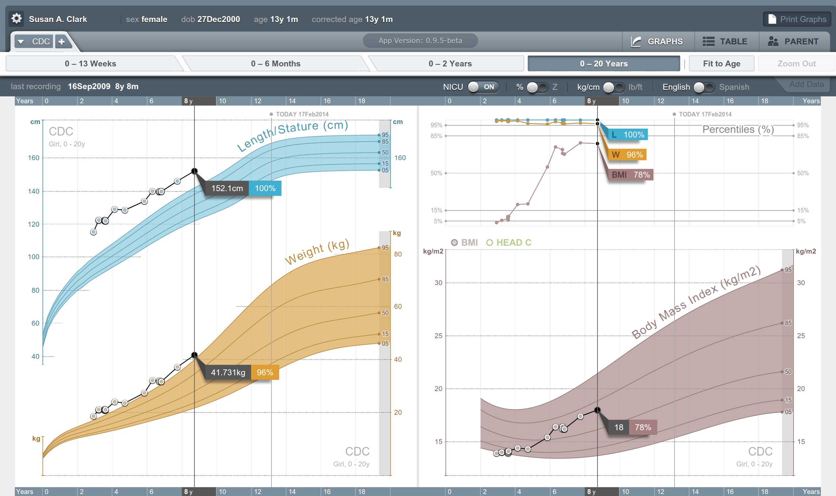


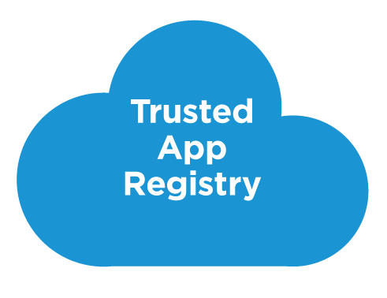



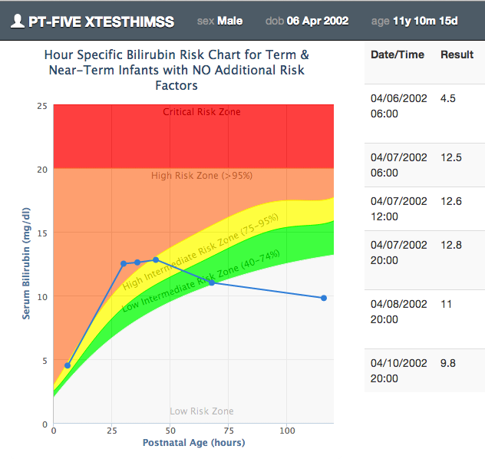







SMART on FHIR
Mobile Apps
Web Apps
OAuth2
REST API
MU-oriented FHIR Data Profiles
Underlying Health IT Systems
Your system here.

Slide 61
SMART on FHIR

Slide 62
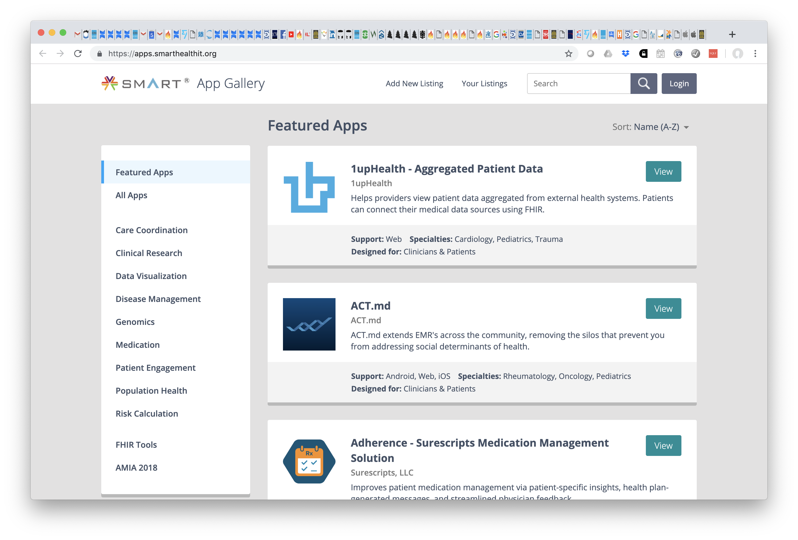
SMART App Gallery

Slide 63
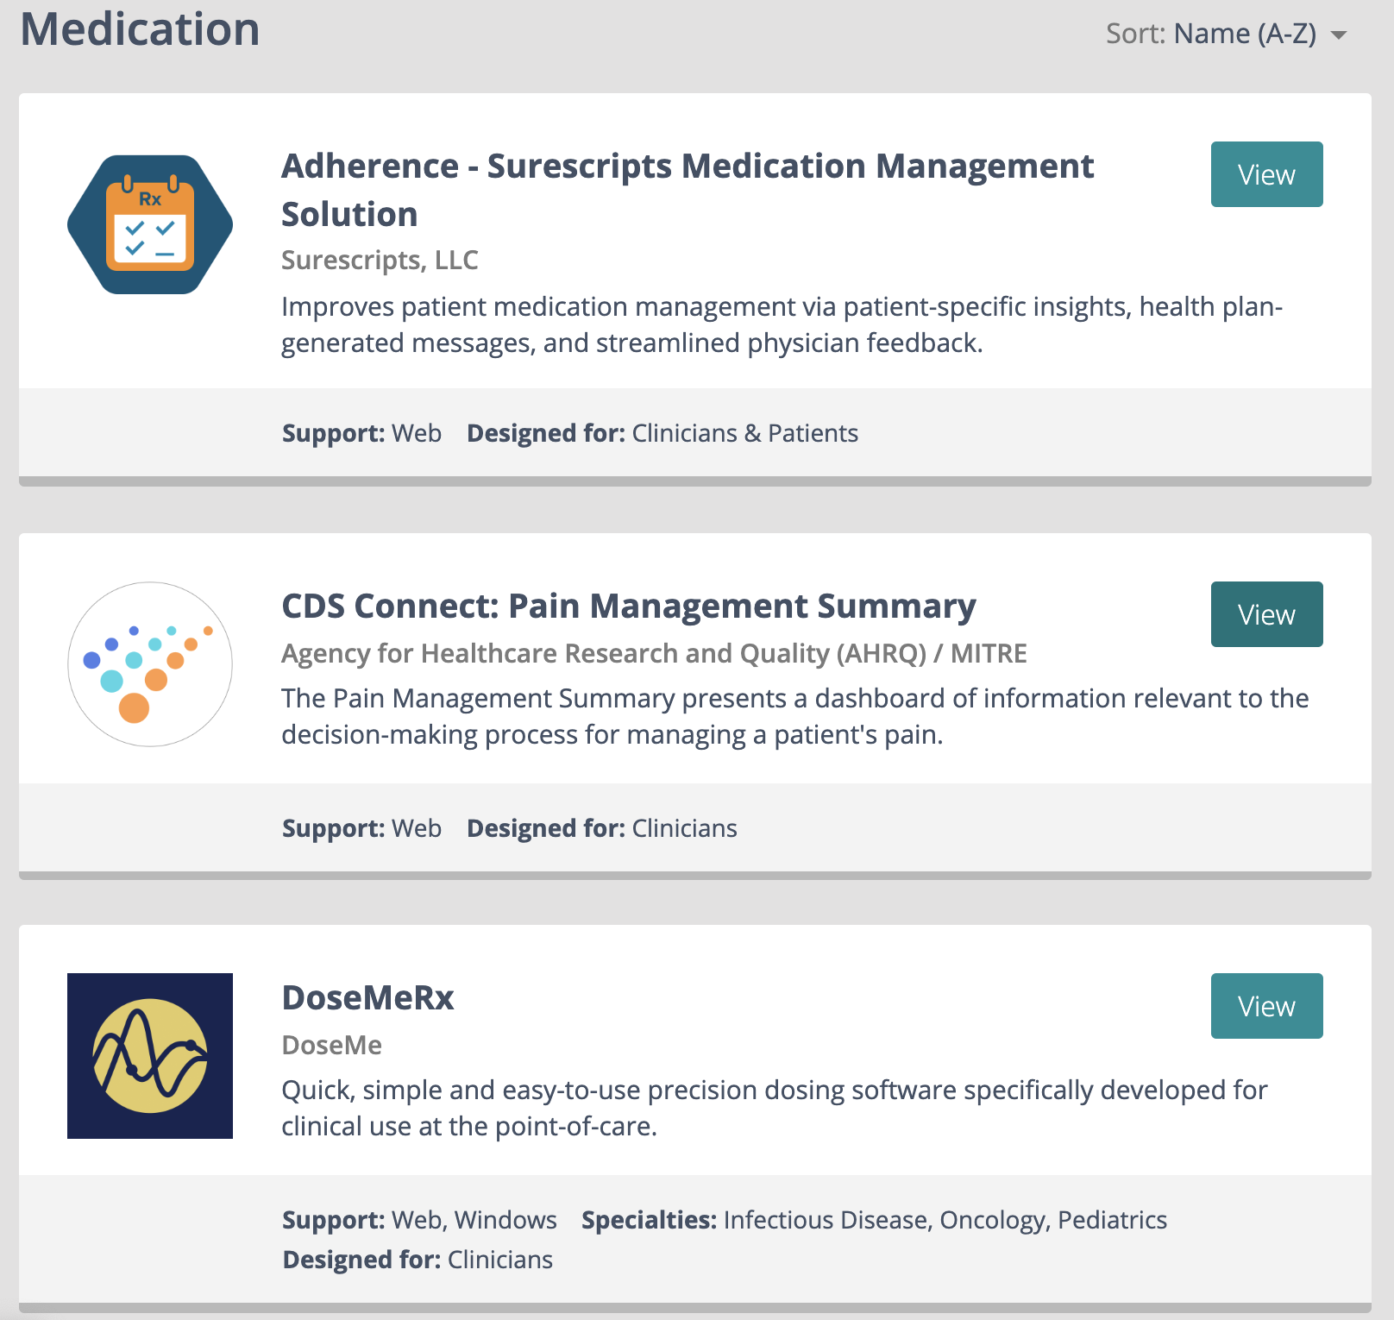
A Few SMART Medication Apps

Slide 64
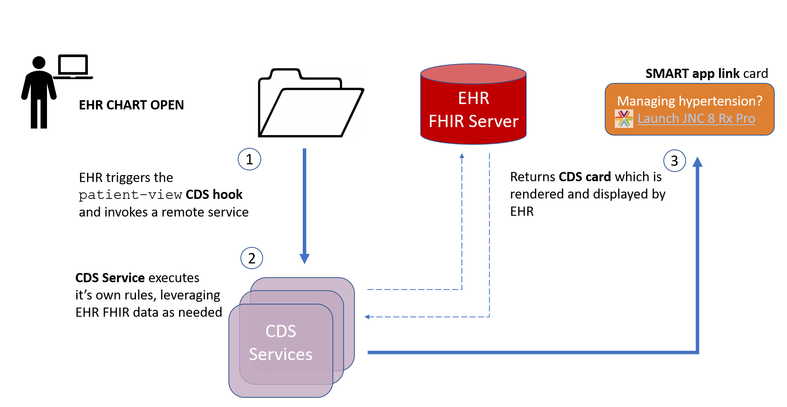
CDS Hooks

Slide 65
Apple HealthKit
Health Records API, Health app
Patients can download their health data from supported healthcare institutions using FHIR
DSTU2 (Argonaut), but expect will update soon
Support allergies, conditions, immunizations, lab results, medications, procedures, and vital signs

Slide 66
Example FHIR Use Scenarios
A patient uses the Apple Health app to access their data from a certified EHR (Epic, Cerner, athenaClinicals) on their mobile (iOS) device via Apple HealthKit
A patient facing app for assistance with managing complex care for diabetes could access relevant lab data via the EHR FHIR API
A clinical decision support app for infectious disease management implemented alongside an EHR can use CDS Hooks to trigger an alert for possible inadequate antimicrobial therapy based on culture and susceptibility results
A SMART on FHIR or other client app could query local and remote FHIR endpoints (with proper authentication and security) from a variety of provider organizations or an HIE to retrieve all medication data for performing medication reconciliation

Slide 67
Recent developments

Slide 68
FHIR in ONC NPRM
API Certification Criterion
Build apps and services on HL7 FHIR and additional implementation specifications
Provide API access and search capabilities for all proposed United States Core Data for Interoperability (USCDI) data for single and multiple patients
Use secure connections that include authentication and authorization capabilities to enable, e.g., single sign-on
Certified APIs would need to implement the SMART Application Launch Framework Implementation Guide, (based on the OAuth 2.0 security standard)

Slide 69
Cerner and FHIR R4
On March 28 Cerner announced that the initial HL7 FHIR R4 implementation is available for Cerner Millennium
Initially limited to CapabilityStatement, Patient, Encounter
Expect in next few months AllergyIntolerance, Binary, DocumentReference, Immunization, Organization, Practitioner, RelatedPerson

Slide 70
FHIR FOR MED Rec

Slide 71
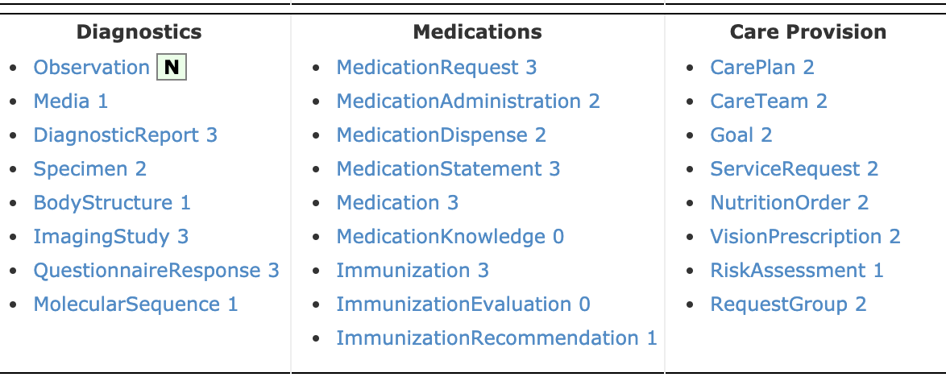
Medication Resources
http://hl7.org/fhir/R4/resourcelist.html

Slide 72
MedicationStatement
The MedicationStatement resource is used to record a medications or substances that the patient reports as being taken, not taking, have taken in the past or may take in the future
It can also be used to record medication use that is derived from other records such as a MedicationRequest.

Slide 73
MedicationAdministration
This resource covers the administration of all medications and vaccines
It will principally be used within care settings (including inpatient) to record the capture of medication administrations, including self-administrations of oral medications, injections, intra-venous adjustments, etc.
But in many situations this data may not be available

Slide 74
MedicationRequest
This resource covers all type of orders for medications for a patient.
This includes inpatient medication orders as well as community orders (whether filled by the prescriber or by a pharmacy). It also includes orders for over-the-counter medications (e.g. Aspirin), total parenteral nutrition and diet/ vitamin supplements.

Slide 75
List
The List resource is a flat, possibly ordered collection of records.
List resources are used in many places, including allergies, medications, alerts, family history, medical history, etc.
List resources can be used to support patient-specific clinical lists as well as lists that manage workflows such as tracking patients, managing teaching cases, etc.

Slide 76
Search
GET [base]/[type]?name=value&...{&_format=[mime-type]}}
Example MedicationStatement search: GET http://yourfhirserver.com/MedicationStatement?code=1594660&system=http://www.nlm.nih.gov/research/umls/rxnorm

Slide 77
More
Will leave the rest up to you!

Slide 78
Questions?
Rob Hausam
rob@hausamconsulting.com
Connect with the FHIR community: FHIR Zulip chat
https://chat.fhir.org/#narrow/stream/terminology

